Slide 1
ECE 368 Basic VHDL
Shantanu Dutt
UIC
Acknowledgement: Extracted from RASSP
http://www.cedcc.psu.edu/ee497f/rassp_10/

Slide 2
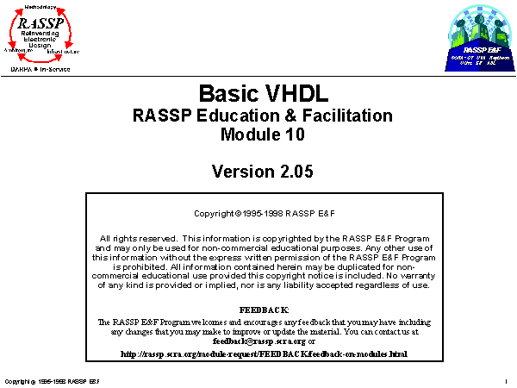
Slide 1 of 93
Notes:

Slide 3
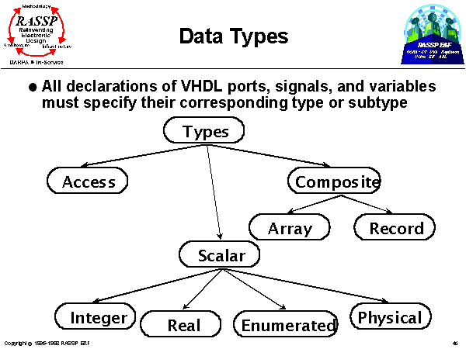
Slide 46 of 93
Notes:
The three defined data types in VHDL are access, scalar, and composite. Note that VHDL 1076-1987 defined a fourth data type, file, but files were reclassified as objects in VHDL 1076-1993. In any case, files will not be discussed in this module but will be covered in RASSP E&F Module 13, 'Advanced Concepts in VHDL’, included in this collection of educational modules.
Simply put, access types are akin to pointers in other programming languages, scalar types are atomic units of information, and composite types are arrays and/or records. These are explained in more detail in the next few slides. In addition, subtypes will also be introduced.

Slide 4
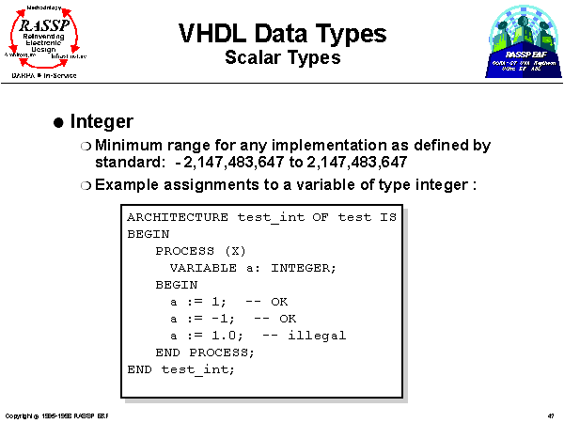
Slide 47 of 93
Notes:
Scalar objects can hold only one data value at a time. A simple example is the integer data type. Variables and signals of type integer can only be assigned integers within a simulator-specific range, although the VHDL standard imposes a minimum range.
In the above example, the first two variable assignments are valid since they assign integers to variables of type integer. The last variable assignment is illegal because it attempts to assign a real number value to a variable of type integer.

Slide 5
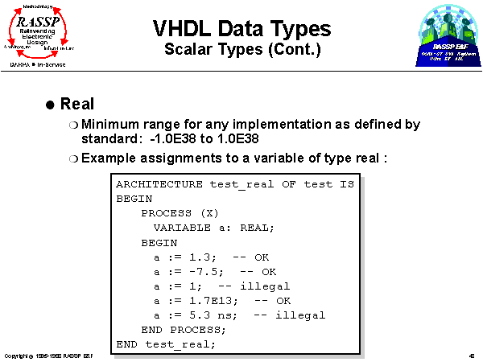
Slide 48 of 93
Notes:
A second simple example is the real data type. This type consists of the real numbers within a simulator-specific (but with a VHDL standard imposed minimum) range. The variable assignment lines marked OK are valid assignments. The first illegal statement above attempts to assign an integer to a real type variable, and the second illegal statement is not allowed since the unit “ns” denotes a physical data type.

Slide 6
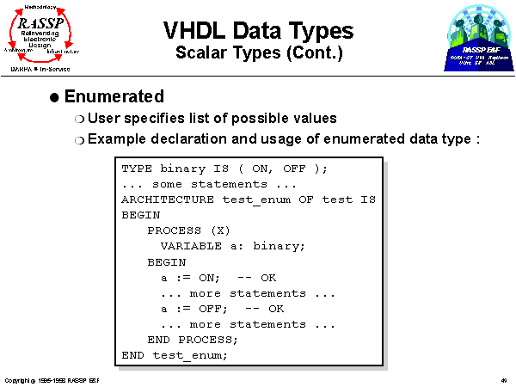
Slide 49 of 93
Notes:
The enumerated data type allows a user to specify the list of legal values that a variable or signal of the defined type may be assigned. As an example, this data type is useful for defining the various states of a FSM with descriptive names.
The designer first declares the members of the enumerated type. In the example above, the designer declares a new type binary with two legal values, ON and OFF.
Note that VHDL is not case sensitive. Typing reserved words in capitals and variables in lower case may enhance readability,

Slide 7
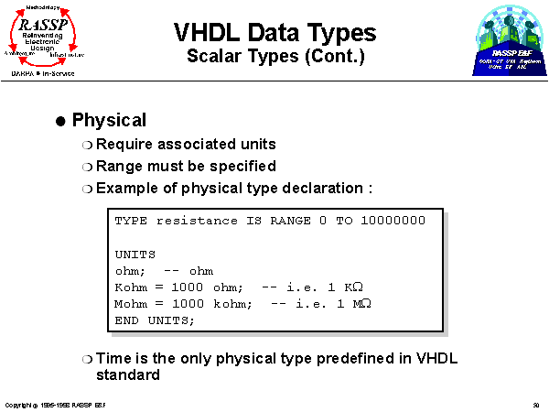
Slide 50 of 93
Notes:
The physical data type is used for values which have associated units. The designer first declares the name and range of the data type and then specifies the units of the type. Notice there is no semicolon separating the end of the TYPE statement and the UNITS statement. The line after the UNITS line states the base unit of of the type. The units after the base unit statement may be in terms of the base unit or another already defined unit.
Note that VHDL is not case sensitive so Kohm and kohm refer to the same unit.
The only predefined physical type in VHDL is time.

Slide 8
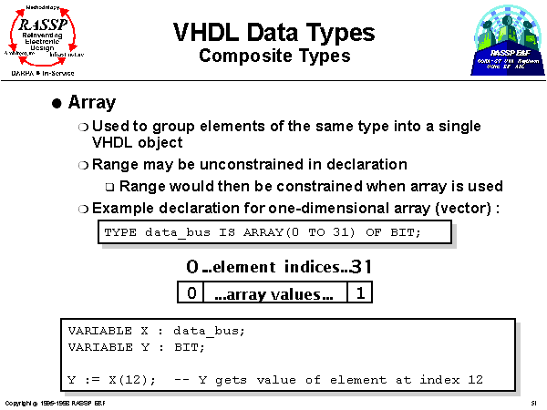
Slide 51 of 93
Notes:
VHDL composite types consists of arrays and records. Each object of this data type can hold more than one value.
Arrays consist of many similar elements of any data type, including arrays. The array is declared in a TYPE statement. There are numerous items in an array declaration. The first item is the name of the array. Second, the range of the array is declared. The keywords TO and DOWNTO designate ascending or descending indices, respectively, within the specified range. The third item in the array declaration is the specification of the data type for each element of the array.
In the example above, an array consisting of 32 bits is specified. Note that individual elements of the array are accessed by using the index number of the element as shown above. The index number corresponds to where in the specified range the index appears. For example, X(12) above refers to the thirteenth element from the left (since the leftmost index is 0) in the array.

Slide 9
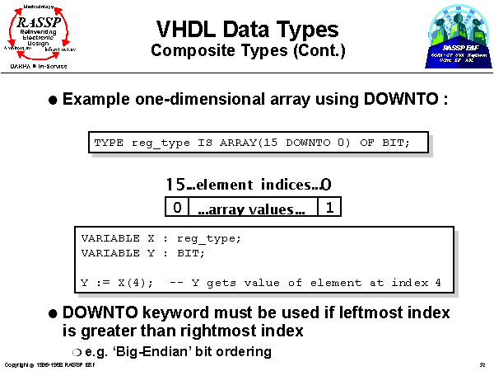
Slide 52 of 93
Notes:
This example illustrates the use of the DOWNTO designator in the range specification of the array. DOWNTO specifies a descending order in array indices so that in the example above, X(4) refers to the fifth element from the right in the array (with 0 being the index for the element furthest to the right in this case).

Slide 10
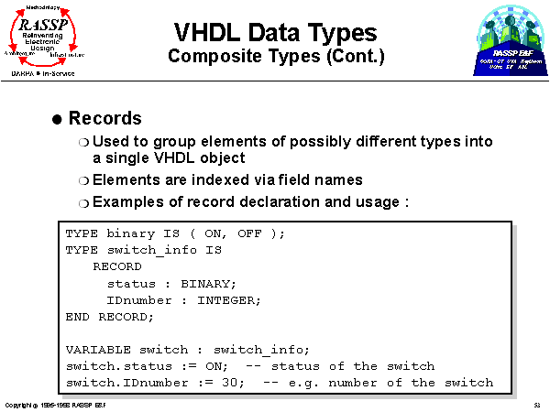
Slide 53 of 93
Notes:
The second VHDL composite type is the record. An object of type record may contain elements of different types. Again, a record element may be of any data type, including another record.
A TYPE declaration is used to define a record. Note that the types of a record's elements must be defined before the record is defined. Also notice that there is no semi-colon after the word RECORD. The RECORD and END RECORD keywords bracket the field names. After the RECORD keyword, the record's field names are assigned and their data types are specified.
In the above example, a record type, switch_info, is declared. This example makes use of the binary enumerated type declared previously. Note that values are assigned to record elements by use of the field names.

Slide 11
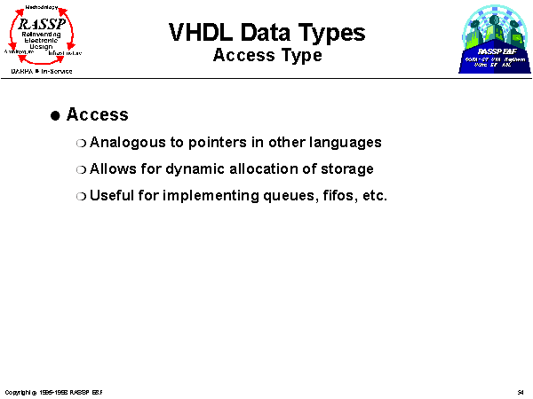
Slide 54 of 93
Notes:
The VHDL access type will not be discussed in detail in this module; it will be covered more thoroughly in the 'Advanced Concepts in VHDL' module appearing in this collection of modules.
In brief, the access type is similar to a pointer in other programming languages in that it dynamically allocates and deallocates storage space to the object. This capability is useful for implementing abstract data structures (such as queues and first-in-first-out buffers) where the size of the structure may not be known at compile time.

Slide 12
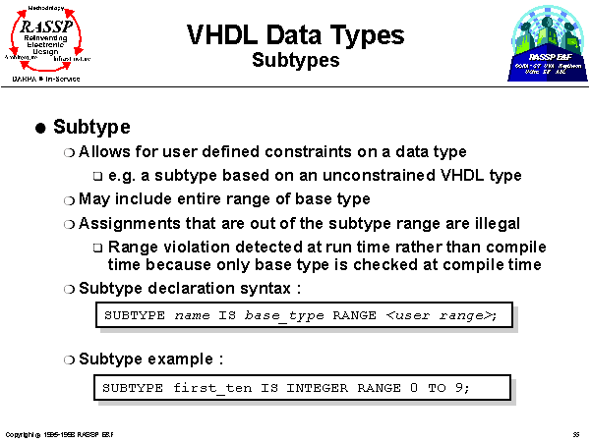
Slide 55 of 93
Notes:
VHDL subtypes are used to constrain defined types. Constraints take the form of range constraints or index constraints. However, a subtype may include the entire range of the base type. Assignments made to objects that are out of the subtype range generate an error at run time. The syntax and an example of a subtype declaration are shown above.

Slide 13
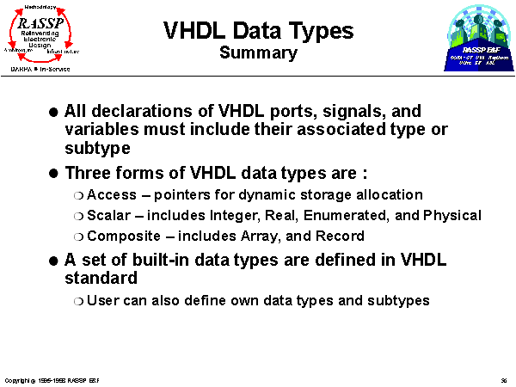
Slide 56 of 93

Slide 14
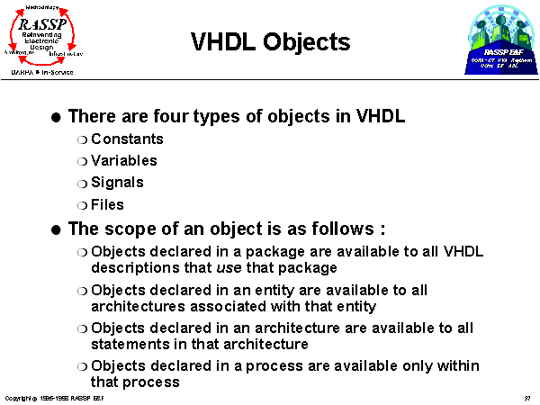
Slide 57 of 93
Notes:
VHDL 1076-1993 defines four types of objects, files, constants, variables, and signals. Simple scoping rules determine where object declarations can be used. This allows the reuse of identifiers in separate entities within the same model without risk of inadvertent errors.
For example, a signal named data could be declared within the architecture body of one component and used to interconnect its underlying subcomponents. The identifier data may also be used again in a different architecture body contained within the same model.

Slide 15
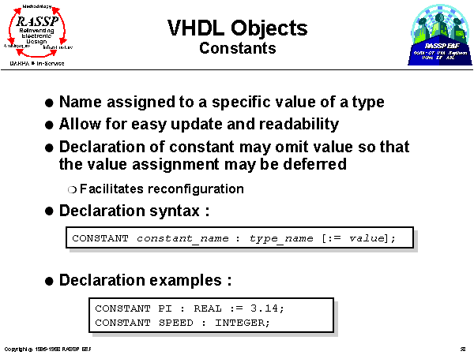
Slide 58 of 93
Notes:
VHDL constants are objects whose values do not change. The value of a constant, however, does not need to be assigned at the time the constant is declared; it can be assigned later in a package body if necessary, for example.
The syntax of the constant declaration statement is shown above. The constant declaration includes the name of the constant, its type, and, optionally, its value.

Slide 16
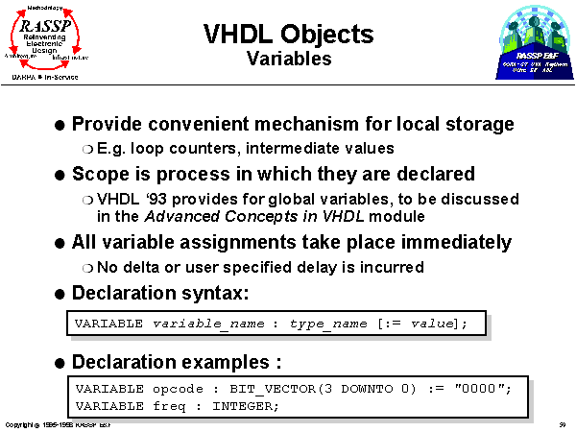
Slide 59 of 93
Notes:
This discussion about VHDL variables does not include global (aka shared) variables which were introduced in the 1076-1993 standard. The discussion of shared variables is deferred to the 'Advanced Concepts in VHDL’ module.
An important feature of the behavior of VHDL variables is that an assignment to a VHDL variable results in the variable assuming its new value immediately (i.e. no simulation time or delta cycles must transpire as is the case for VHDL signals). This feature allows the sequential execution of statements for a behavioral descriptiin within VHDL processes where variables are used as placeholders for temporary data, loop counters, etc.
Examples of variable declarations and assignments are shown above. Note that when a variable is declared, it may optionally be given an initial value as well.

Slide 17
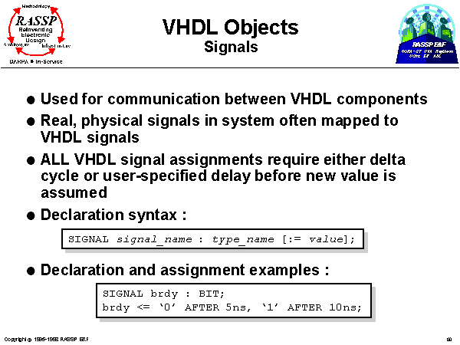
Slide 60 of 93
Notes:
Signals are used to pass information directly between VHDL processes and entities. As has already been said, signal assignments require a delay before the signal assumes its new value. In fact, a particular signal may have a series of future values with their respective timestamps pending in the signal's waveform. The need to maintain a waveform results in a VHDL signal requiring more simulator resources than a VHDL variable.

Slide 18
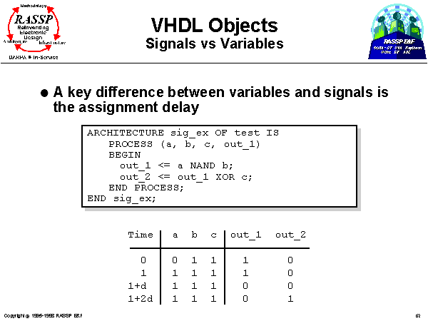
Sensitivity list: All signals appearing at the input or RHS of all signal or variable assignment statements
Slide 62 of 93
Notes:
To review, note that some delay must transpire after a VHDL signal assignment statement before the signal assumes its new value. Examples will be used in this and the next slide to illustrate the difference between signals and variables. The example shown above utilizes signals. Note that in this example, a, b, c, out_1, and out_2 are signals that are declared elsewhere, e.g. in the component’s entity.
The table indicates the values for the various signals at the key times in the example. At time 1, a new value of 1 is observed on a. This causes the process sensitivity list to fire and results in a 0 being assigned to out_1. The signal assignment statement for out_2 will also be executed but will not result in a new assignment to out_2 because neither out_1 nor c will be changed at this time. At time 1+d (i.e. 1 plus 1 delta cycle), out_1 assumes its new value causing the process sensitivity list to fire again. In this process execution, the statement for out_1 will be executed again but no new assignment will be made because its right hand side parameters have not changed. The out_2 assignment statement, however, results in a 1 being assigned to out_2. At time 1+2d, out_2 assumes its new value of 1. This example, then, requires 2 delta cycles and two process executions to arrive at its quiescent state following a change to a (or b, for that matter).

Slide 19
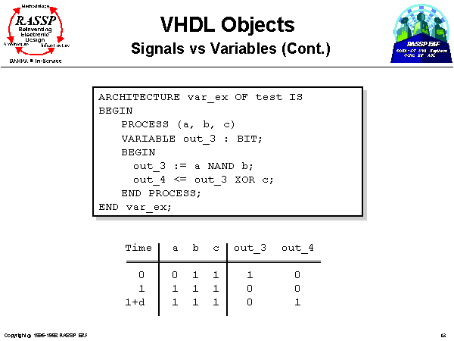
Slide 63 of 93
Notes:
(1) In this example, variables are used to achieve the same functionality as the example in the previous slide. In this example, however, when there is a change in a at time 1, out_3 will assume its new value at time 1 because it is a variable, and VHDL variable assignment statements result in the new values being assumed immediately. The new value for out_4, therefore, will be calculated with the new out_3 value and results in an assignment to a value of ‘1’ being scheduled for one delta cycle in the future.
(2) However, that in this example, the order in which the statements appear within the process is important because the two statements are executed sequentially, and the process will only be executed once as a result of the single change in a.
(3) Combinational circuits (circuits without feedback loops) can be described using vars for the internal values, but there is not an accurate automatic delay incurred in the circuit’s simulation.

Slide 20
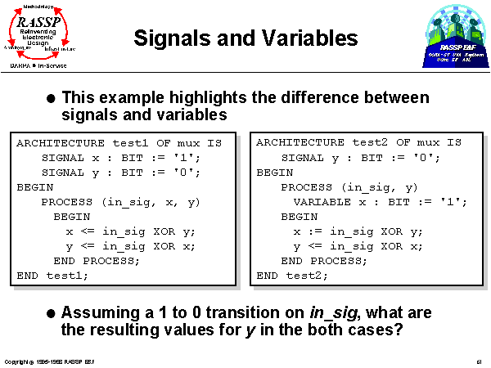
xor
x=1->0->1->0…
in_sig=0
xor
y=0->1->0->1
Need a structural or dataflow description of this circuit to get the correct o/p
A behavioral description w/ sequential semantics will give an incorrect o/p as explained below
Slide 61 of 93
Notes:
Note that signal assignments require that a delay be incurred before the signals assume their new values.
In the example on the left, the signal assignment for x leads to a ‘0’ being scheduled on x one delta cycle in the future. Note that x still holds its original value of ‘1’, however, when the signal assignment for y is evaluated. Thus, the signal assignment statement for y evaluates to ‘1’, and y will assume this new value one delta cycle in the future. This contrived example actually leads to x and y swapping values in delta time while in_sig has a value of ‘0’.
In the example on the right, the variable assignment for x leads to x assuming a ‘0’ immediately. Thus, when the signal assignment for y is evaluated, x already has its new value and the statement evaluates to a ‘0’, resulting in y retaining its original value. This example does not perform the swapping in delta time that would be performed by the example on the left.

Slide 21
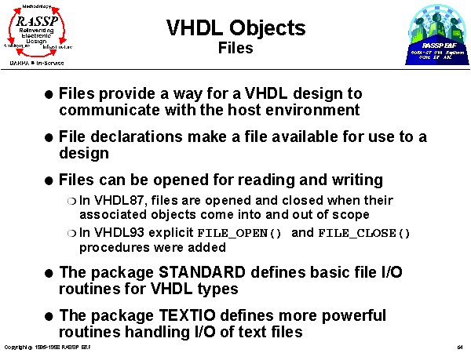
Slide 64 of 93
Notes:
The VHDL file object is introduced above. Files may be opened in read or write mode, and once a file is opened, its contents may only be accessed sequentially. A detailed description of the use of file objects is beyond this module and will be discussed further in the 'Advanced Concepts in VHDL’ module.

Slide 22
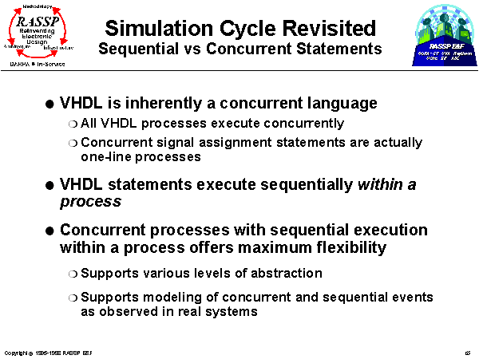
Slide 65 of 93
Notes:
In essence, VHDL is a concurrent language in that all processes execute concurrently. All VHDL execution can be seen as taking place inside processes; concurrent signal assignment statements have already been described as being equivalent to one-line processes. Within a process, however, VHDL adheres to a sequential mode of execution where statements within a process are executed in "top-to-bottom” fashion until the process suspends at a wait statement.
This simultaneous support of concurrent and sequential modes allows great flexibility in modeling systems at multiple levels of design and description abstraction.

Slide 23
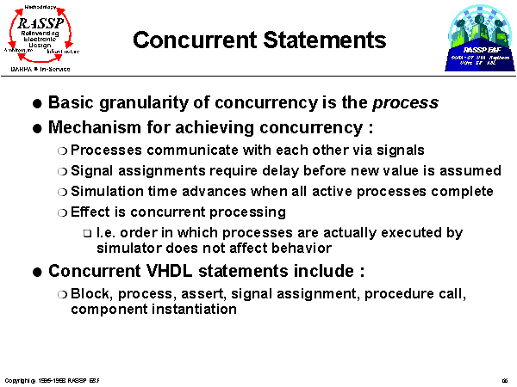
+ current signal values are used (as opposed to new, i.e., future-time values) in the processing of statements
or block
Slide 66 of 93

Slide 24
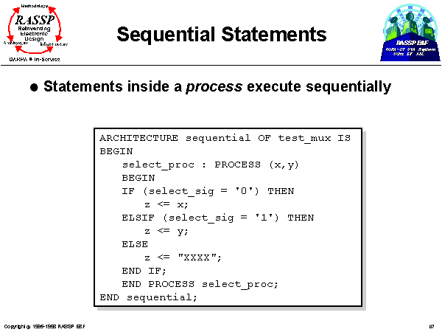
Any problem w/ this description
of a 2:1 mux?
Slide 67 of 93
Notes:
Statements in a VHDL process are executed sequentially. A process may also include a sensitivity list which is declared immediately after the PROCESS keyword. The process executes when there is a transition on any of the specified signals. Alternatively, a process would include at least one wait statement to control when and where a process may suspend so that signals with pending signal assignments may assume their new values. Actually, a sensitivity list is equivalent to a wait statement at the bottom of a process which suspends execution until there is a transition on one of the signals on the sensitivity list.
The wait statement will be covered in detail in the Behavioral VHDL module.
In the example above, the sensitivity list includes signals x and y. The process can also be named; the process in the example above is named select_proc.

Slide 25
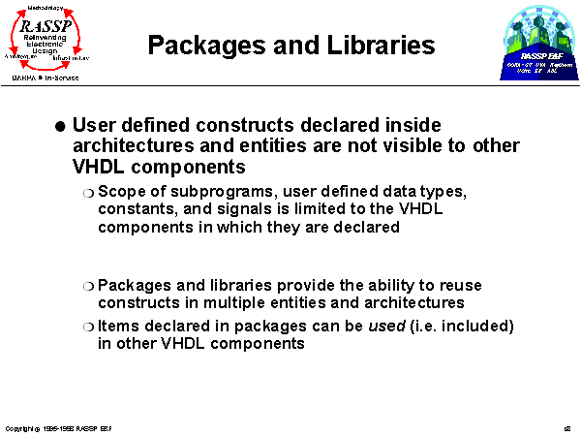
Slide 68 of 93
Notes:
VHDL provides the package mechanism so that user-defined types, subprograms, constants, aliases, etc. can be defined once and reused in the description of multiple VHDL components.
VHDL libraries are collections of packages, entities, and architectures. The use of libraries allows the organization of the design task into any logical partition the user chooses (e.g. component libraries, package libraries to house reusable functions and type declarations).

Slide 26
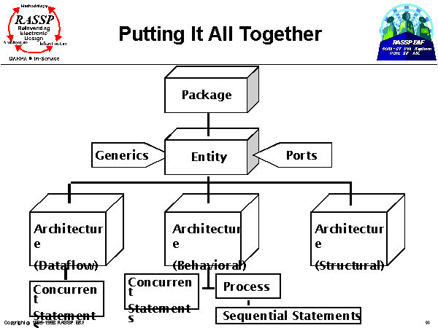
Slide 91 of 93
Notes:
This diagram is a graphical representation of many of the VHDL constructs talked about in this module. In summary, generics and ports are used in the entity definition which serves as the module's interface to other modules. Each entity can have any number of different descriptions of module behavior included in VHDL architectures (although only one architecture can be instantiated per module use). Architectures use concurrent statements and possibly processes to allow great flexibility in how behavior is described.

Slide 27
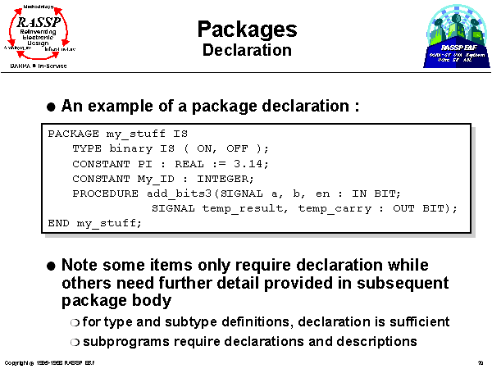
Slide 70 of 93
Notes:
his is an example of a package declaration. The package declaration lists the contents of the package. The declaration begins with the keyword PACKAGE and the name of the package followed by the keyword IS. VHDL declaration statements are then included, such as type declarations, constant declarations, and subprogram declarations. For many VHDL constructs, such as types, declarations are sufficient to fully define them. For a subprogram, however, the declaration only specifies the parameters required by the function or procedure; the operation of the subprogram appears later in the package body. The package declaration ends with END and the package name.

Slide 28
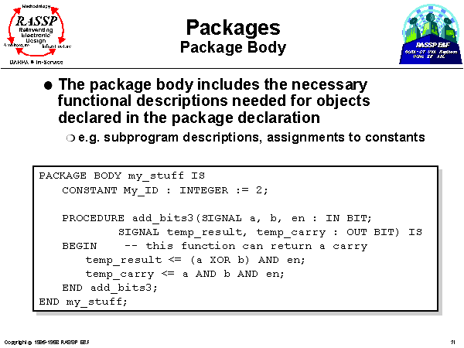
Slide 71 of 93
Notes:
The package body contains the functional descriptions for the subprograms and other items declared in the corresponding package declaration.
Once a package is defined, its contents are made visible to VHDL entities and architectures via a USE clause which is analogous to the include statement of some other programming languages.

Slide 29
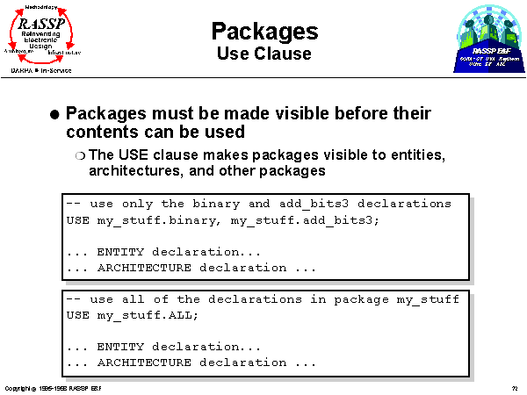
Slide 72 of 93
Notes:
Packages are made visible to a VHDL description through the use of the USE clause. This statement comes at the beginning of the entity or architecture file and makes the contents of a package available within that file.
The USE clause can select all or part of a particular package. In the first example above, only the binary data type and add_bits3 procedure are made visible. In the second example, the full contents of the package are made visible by use of the keyword ALL in the use clause.

Slide 30
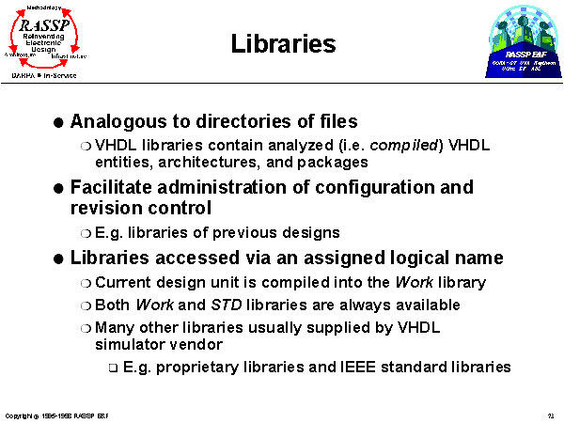
Slide 73 of 93
Notes:
Increasingly complex VLSI technology requires configuration and revision control management. Additionally, efficient design calls for reuse of components when applicable and revision of library components when necessary.
VHDL uses a library system to maintain designs for modification and shared use. VHDL refers to a library by an assigned logical name; the host operating system must translate this logical name into a real directory name and locate it. The current design unit is compiled into the Work library by default; Work is implicitly available to the user with no need to declare it. Similarly, the predefined library STD does not need to be declared before its packages can be accessed via use clauses. The STD library contains the VHDL predefined language environment, including the package STANDARD which contains a set of basic data types and functions and the package TEXTIO which contains some text handling procedures.

Slide 31
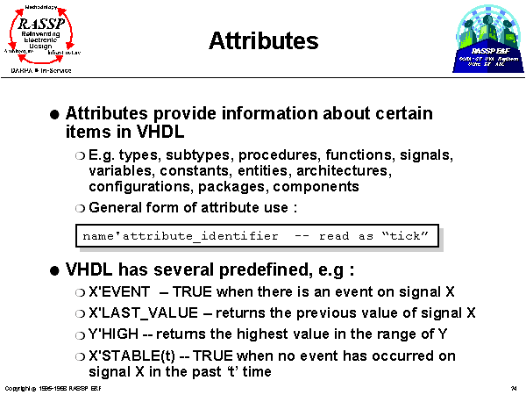
Slide 74 of 93
Notes:
Attributes may be used to communicate information about many different items in VHDL. Similarly, attributes can return various types of information. For example, an attribute can be used to determine the depth of an array, its range, its leftmost index, etc. Additionally, the user may define new attributes to cover specific situations. This capability allows user-defined constructs and data types to use attributes. An example of the use of attributes is in assigning information to a VHDL construct, such as board location, revision number, etc.
A few examples of predefined VHDL attributes are shown above. Note that, by convention, the apostrophe marking the use of an attribute is pronounced tick (e.g. 'EVENT is pronounced "tick EVENT").

Slide 32
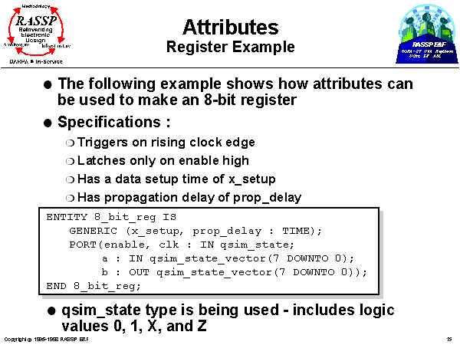
Slide 75 of 93
Notes:
he example presented on this and the next three slides is a simple rising clock edge triggered 8-bit register with an active-high enable. The register has a data setup time of x_setup and a propagation delay of prop_delay.
The input and output signals of this register use the QSIM_STATE logic values. These values include logic 0, 1, X and Z. The a and b signals use the QSIM_STATE_VECTOR type which is an array of QSIM_STATE type vectors.

Slide 33
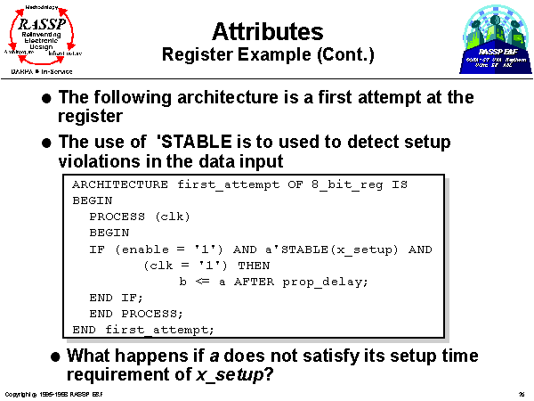
Slide 76 of 93
Notes:
This implementation of the 8-bit register uses the 'STABLE attribute to determine if the input satisfies the setup time requirement of the register. If the setup requirement is not met, the body of the IF statement will not execute, and the value on a will not be assigned to b.
Note that although the process checks that clk and enable are ‘1’ to store the data, it does not consider the possibility that clk may have transitioned to ‘1’ from either ‘X’ or ‘Z’.

Slide 34
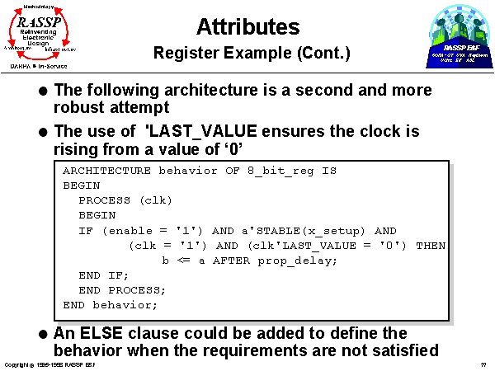
else b <= ‘XXXXXXXX’ after prop_delay;
Slide 77 of 93
Notes:
This implementation adds a check for '0' to '1' transitions on clk by using the 'LAST_VALUE attribute on the signal clk.

Slide 35
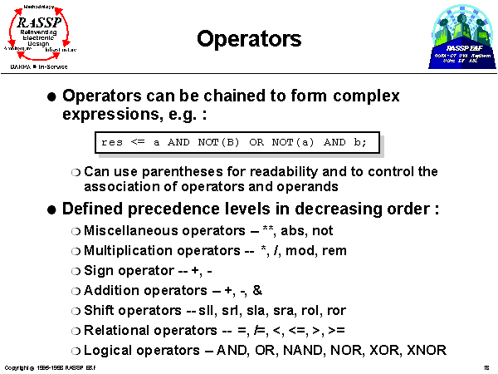
Slide 78 of 93
Notes:
The list of predefined operators in VHDL is shown above. The logical and relational operators are similar to those in other languages. The addition operators are also familiar except for the concatenation operator which will be discussed in the next slide. The multiplication operators are also typical (e.g. the mod operator returns the modulus of the division and the rem operator returns the remainder). Finally, the miscellaneous operators provides some useful frequently used functions.

Slide 36
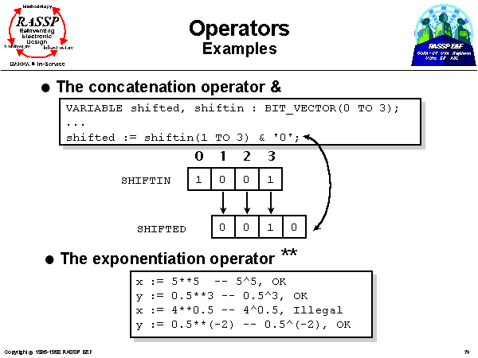
left-shift operation
Slide 79 of 93
Notes:
The concatenation operator joins two vectors together. Both vectors must be of the same type. The example given above performs a logical shift left for a four bit array.
For the exponentiation operator ** from the package STD, the exponent must be an integer; no real exponents are allowed. Negative exponents are allowed only with real numbers. Other packages can be found that include overloaded operators (discussed in Module 12) for exponentiation with real and negative arguments.

Slide 37
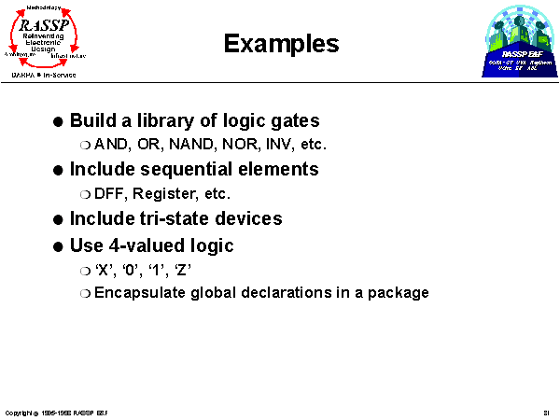
Slide 81 of 93

Slide 38
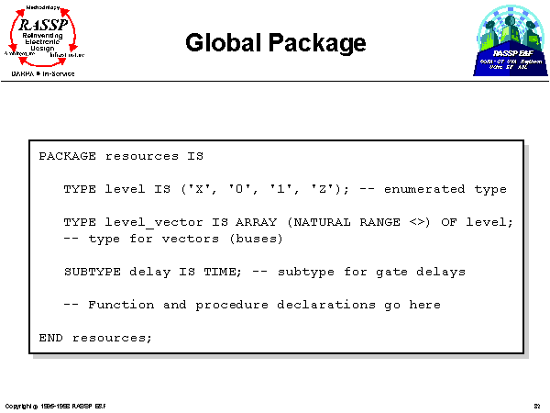
Slide 82 of 93
This is the package declaration for the user defined four valued type package. It includes the four valued enumerated type itself, a vector or array of that type, and a subtype of type time to be used for delay values. Functions and/or procedures could be declared in the package (with their actual implementation descriptions included in the package body), but that will be deferred until module 12, Behavioral VHDL.

Slide 39
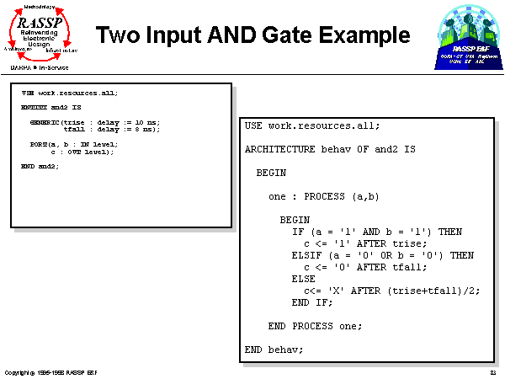
Slide 83 of 93
This is a simple 2 input AND gate. Note that the entity includes generics for rise time and fall time, and the two input and one output ports.
The architecture contains the “behavior” of the AND gate. A single process statement is used which executes anytime either the a or b inputs change (because they are in the process sensitivity list - see module 12). A simple if statement is used to determine what the correct output should be, and the proper delay is inserted by the AFTER clause.
Note that the USE construct is needed in both cases if Entity and Architecture code segments are contained within separate files.

Slide 40
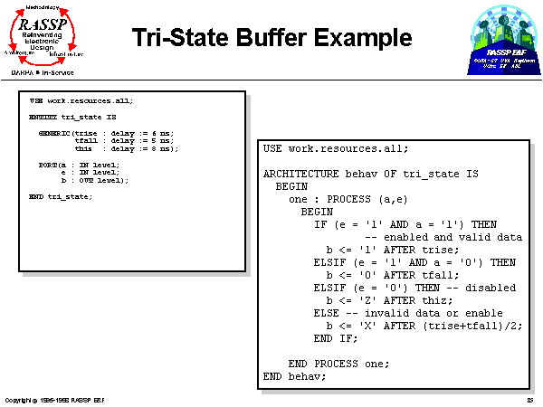
Slide 85 of 93
This is a tri-state buffer example. It is similar to the AND gate, but in this case, it uses the ‘Z’ value as well as the ‘X’ value. Also, a thiz delay (to indicate a driver “turn off” time ) is used in addition to the rise and fall delay times.
Note that the USE construct is needed in both cases if Entity and Architecture code segments are contained within separate files.

Slide 41
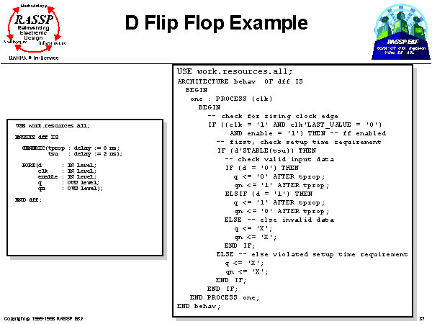
Can add “after tprop”
for q, qn <= ‘X’;
Slide 87 of 93
This is a DFF example that illustrates the use of signal attributes. Notice the ‘LAST_VALUE attribute is used in the clock statement to recognize a ‘0’ to ‘1’ rising edge transition (the last value has to be a ‘0’ to avoid triggering on ‘X’ or ‘Z’ to ‘1’ transitions).
Also, the ‘STABLE attribute is used at each rising clock edge to determine if the d input has satisfied the setup time requirement.
Note that the USE construct is needed in both cases if Entity and Architecture code segments are contained within separate files.

Slide 42
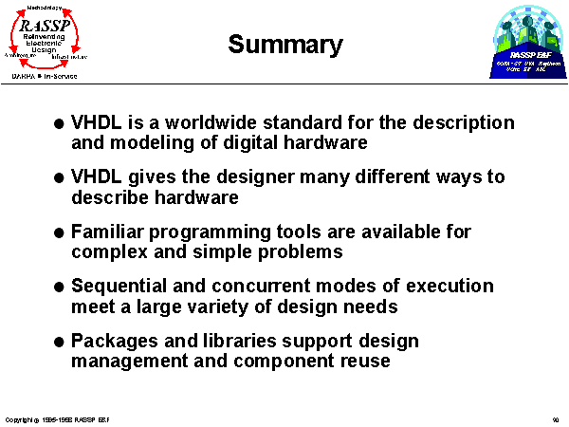
Slide 90 of 93

Slide 43
Slide 91 of 93
Notes:
This diagram is a graphical representation of many of the VHDL constructs talked about in this module. In summary, generics and ports are used in the entity definition which serves as the module's interface to other modules. Each entity can have any number of different descriptions of module behavior included in VHDL architectures (although only one architecture can be instantiated per module use). Architectures use concurrent statements and possibly processes to allow great flexibility in how behavior is described.

Slide 44
Library IEEE;
use IEEE.STD_LOGIC_1164.all;
use IEEE.std_logic_arith.all;
entity tb2to4 is
end entity tb2to4;
architecture structure_proc of tb2to4 is
component dec2to4 is
port (x,y:in bit;
out_sig:out bit_vector(3 downto 0));
end component dec2to4;
signal ip:bit_vector(1 downto 0);
signal op:bit_vector(3 downto 0);
constant PERIOD : time := 10 ns;
begin
dec1:dec2to4 port map(ip(0),ip(1),op);
P:process
variable index:integer;
variable temp:std_logic_vector(1 downto 0);
begin
for n in 0 to 3 loop -- in a loop use index variable to get input value
temp := conv_std_logic_vector(n,2); -- take value of n convert 3 bit vector
-- as soon as we assign value to ip
ip <= to_bitvector(temp);
wait for PERIOD; -- wait 8 ns (this time needs to be somewhat larger
-- than the worst case circuit delay (6 ns for 2-4 dec)
end loop;
wait;
end process P;
end architecture structure_proc;

Slide 45
configuration Config_2to4 of tb2to4 is -- configuration and entity names
for structure_proc -- architecture name of the entity
for dec1:dec2to4 use entity WORK.dec2to4(behav); -- label of statement in
-- which dec2to4 is instantiated
-- In the above statement textually replace architecture "behav" with
-- the other two architectures of dec2to4 and recompile this testbench in
-- order to test the alternate architectures
end for;
end for;
end configuration Config_2to4;

